Slide 1
HABIT
MASTERY LEAGUE
Trajuan Smith & Raiyan Haque
Mobile App Development

Slide 2
What is this project about?
Who is it for?
What does it aim to solve?
This project is a habit tracking mobile application designed to help users, especially students, build and maintain consistent daily routines.
It is aimed at students and individuals who struggle with staying consistent in habits like studying, exercising, or personal development.
The app provides a structured way to track habits, maintain streaks, and visualize progress, helping users stay accountable and motivated over time.

Slide 3
How does our app solve this problem?
How do users stay consistent?
How do users understand their progress?
How do we keep users motivated?
The app provides a structured habit tracking system where users can create and manage their daily routines in one centralized place.
It uses streak tracking and milestone-based progress to encourage users to maintain consistency and build long-term habits over time.
The app offers insights and statistics, allowing users to visualize their performance through trends, completion data, and habit analytics.
Motivational feedback, reminders, and progress-based rewards help users stay engaged and accountable throughout their habit-building journey.

Slide 4
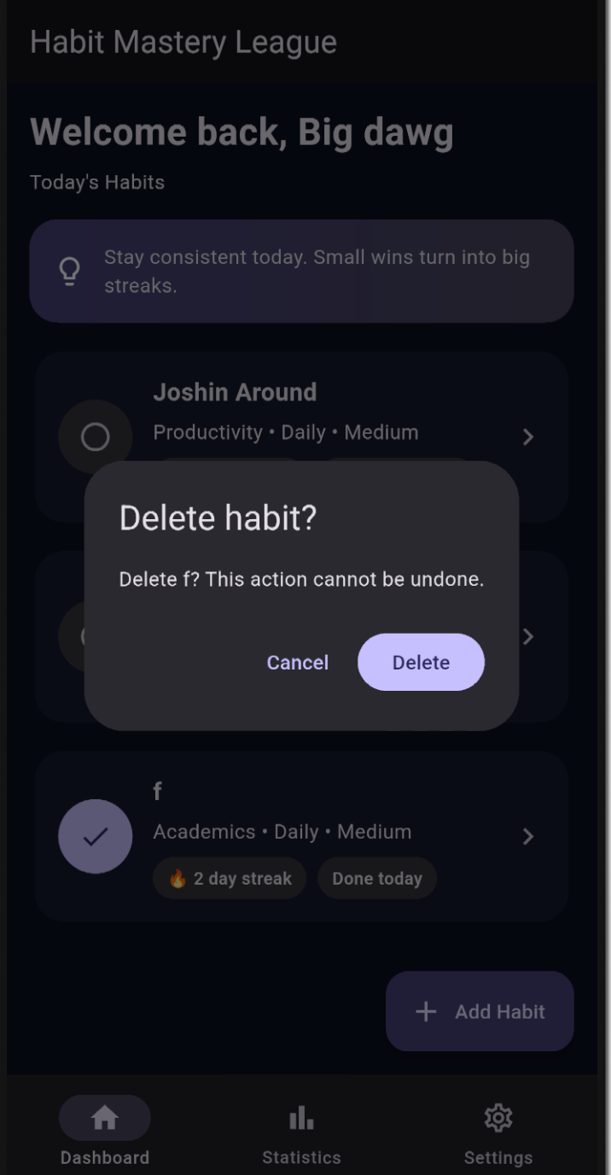
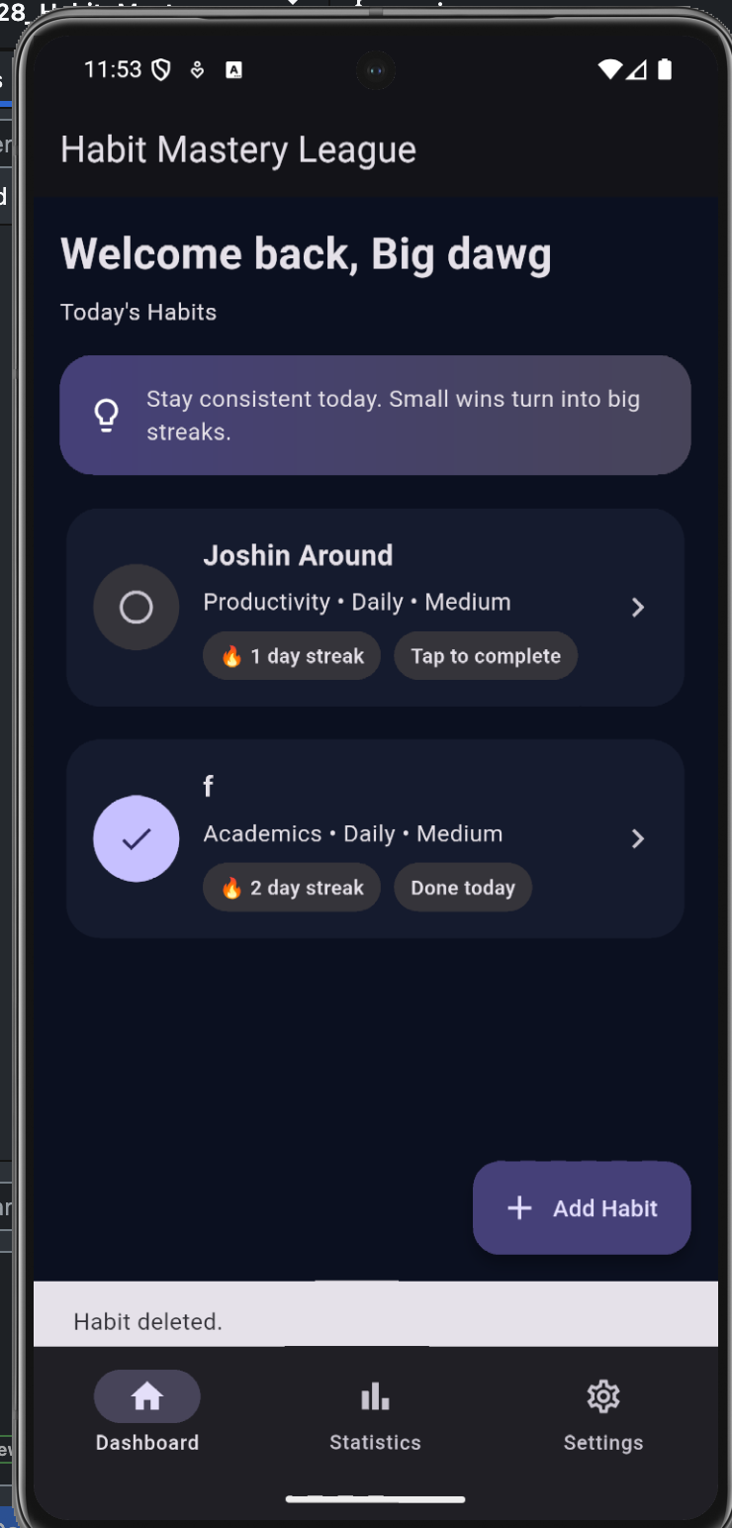
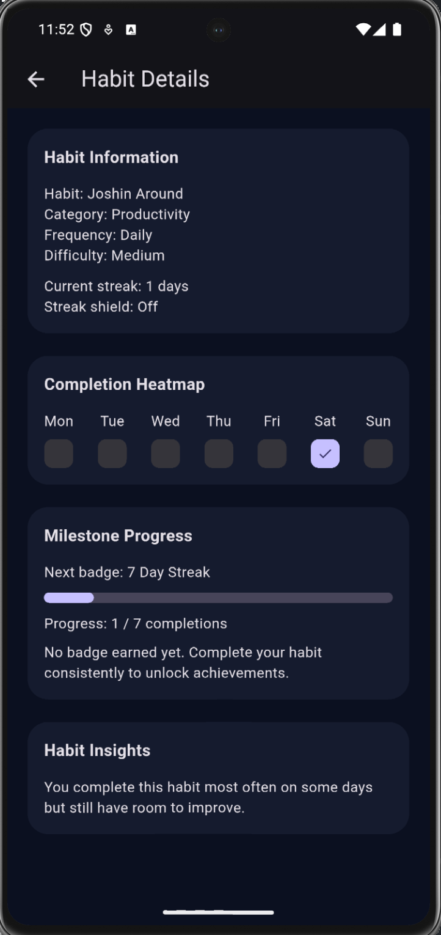
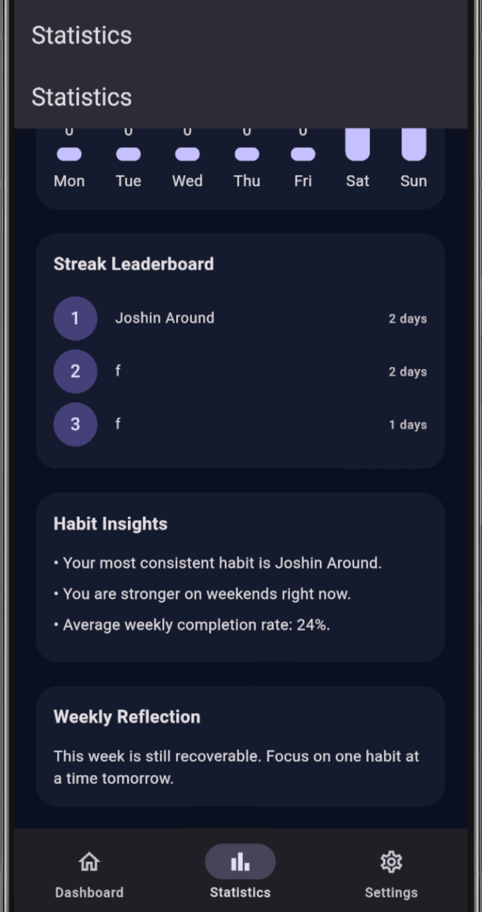
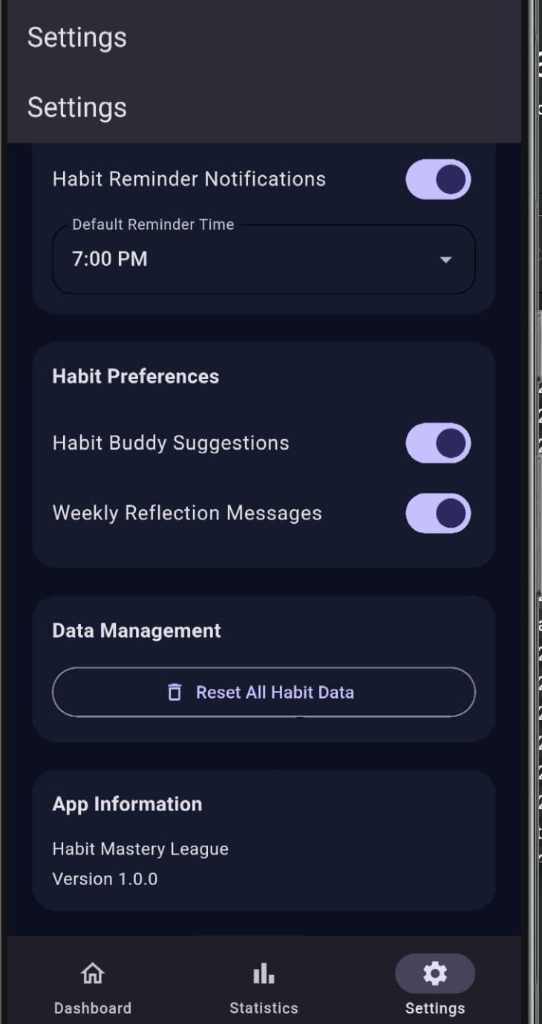
Habit Deletion Flow
Daily Habit Dashboard
Detailed Habit Insights
Analytics & Performance Tracking
Customization & Preferences
Allows users to safely remove habits with a confirmation prompt to prevent accidental actions.
Displays all habits with streak tracking and enables quick daily completion with one tap.
Shows in-depth information including streaks, completion heatmaps, and milestone progress.
Provides visual insights such as weekly trends, leaderboards, and habit performance metrics.
Allows users to personalize notifications, themes, and habit-related settings.

Slide 5
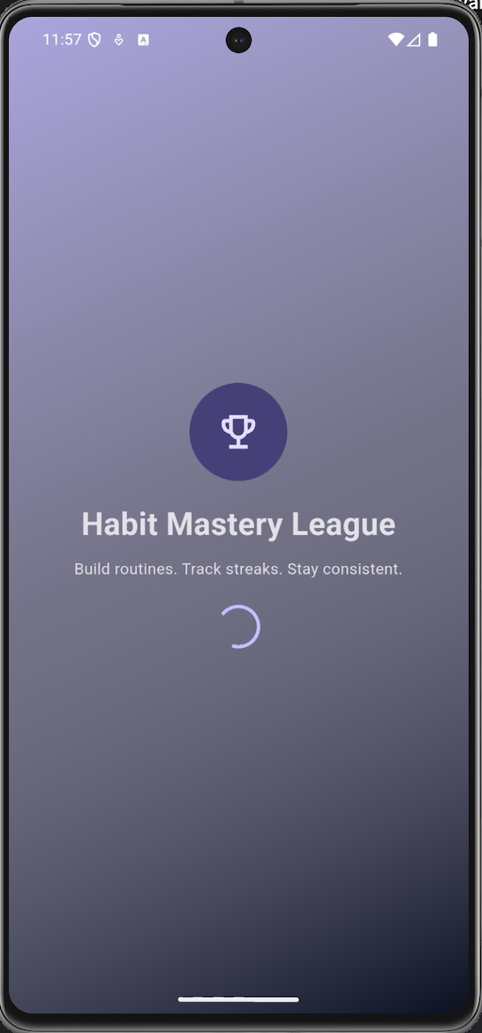
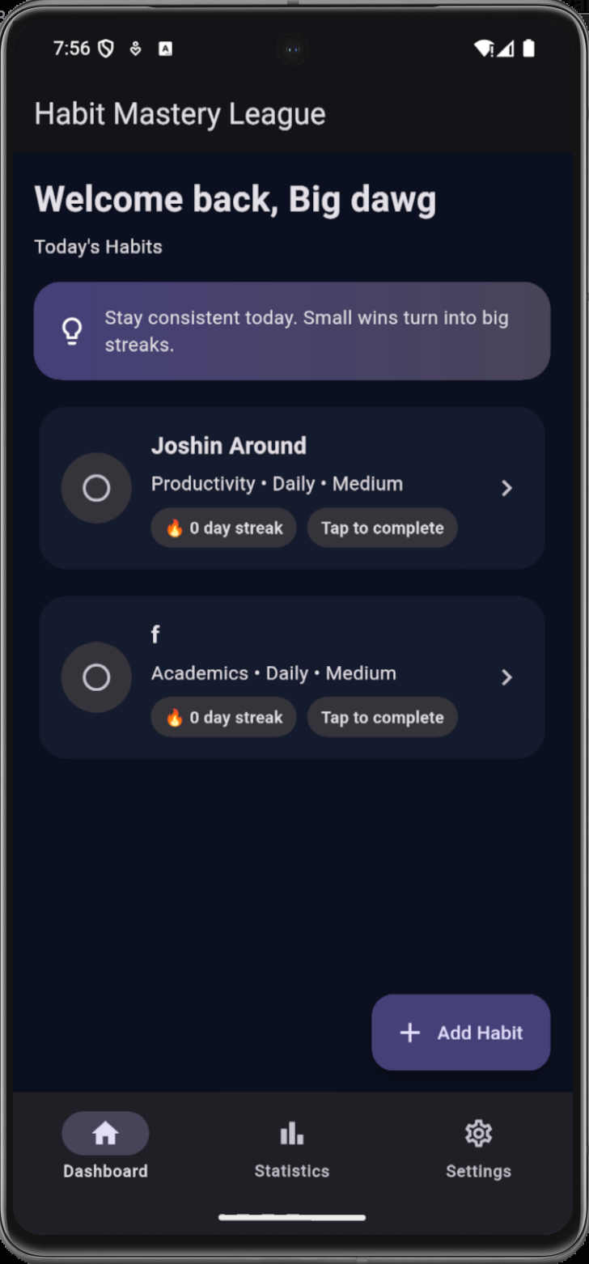
Central DashBoard
Splash Screen

Slide 6
Architecture (Layered Design)
UI Layer
Screens and widgets
Repository Layer
Handles app logic and data flow
Database Layer (SQLite)
Stores habit data and completion logs
Preferences Layer (SharedPreferences)
Persists user preferences and app settings

Slide 7
Database Design (SQLite)
Tables
Habits:
Stores habit configuration
id (Primary Key)
name, category, frequency
difficulty, milestone_goal
Habit_logs:
Stores daily completion data
id (Primary Key)
habit_id (Foreign Key)
log_date, completed
Key Design Decisions:
Foreign key links logs → habits
UNIQUE(habit_id, log_date) prevents duplicates
Boolean stored as integers (0 or 1)

Slide 8
Preferences (SharedPreferences)
Stored Preferences:
Username
Dark mode setting
Notification preferences
Default reminder time
Habit buddy & reflection settings
Key Idea: Data persists locally across app sessions

Slide 9
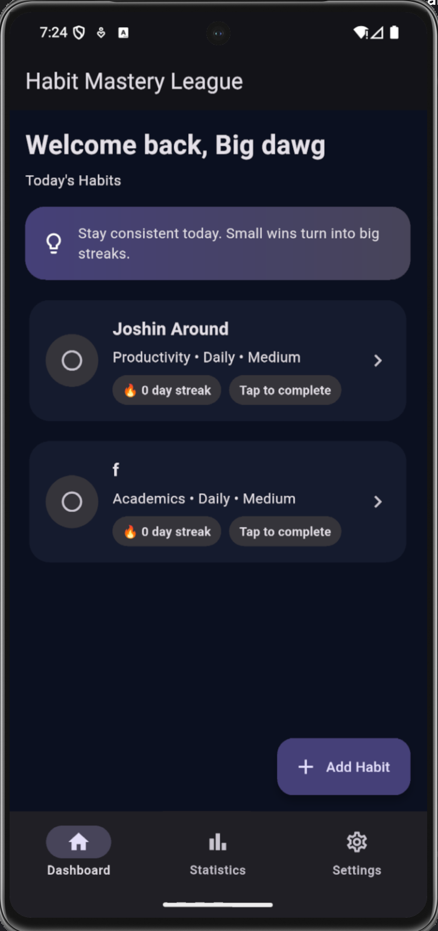
Dashboard Overview
Main Features
Displays all daily habits in one place
Shows real-time streak progress
One-tap habit completion system
Quick access to add new habits
Motivational message to encourage consistency
Centralized dashboard for quick tracking and daily engagement

Slide 10
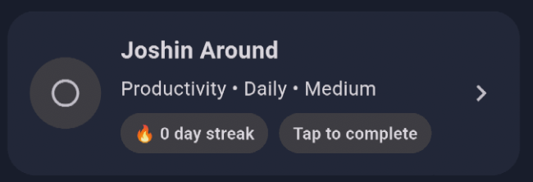
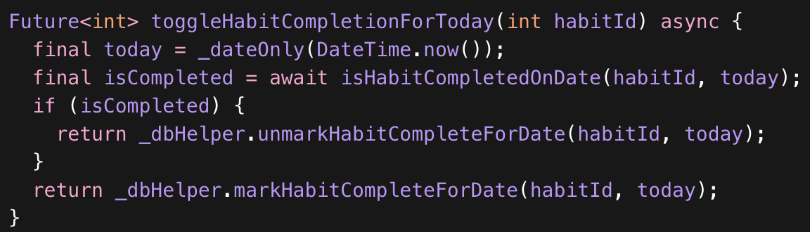
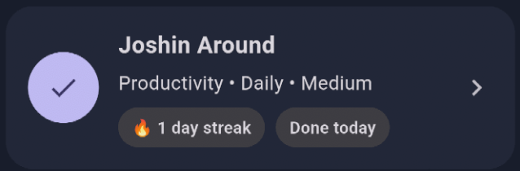
Feature Trace: Mark Habit Complete
User Action:
Tap habit on Dashboard
Flow:
UI triggers repository function
Repository processes logic
Database updates habit_logs table
UI reloads updated data

Slide 11
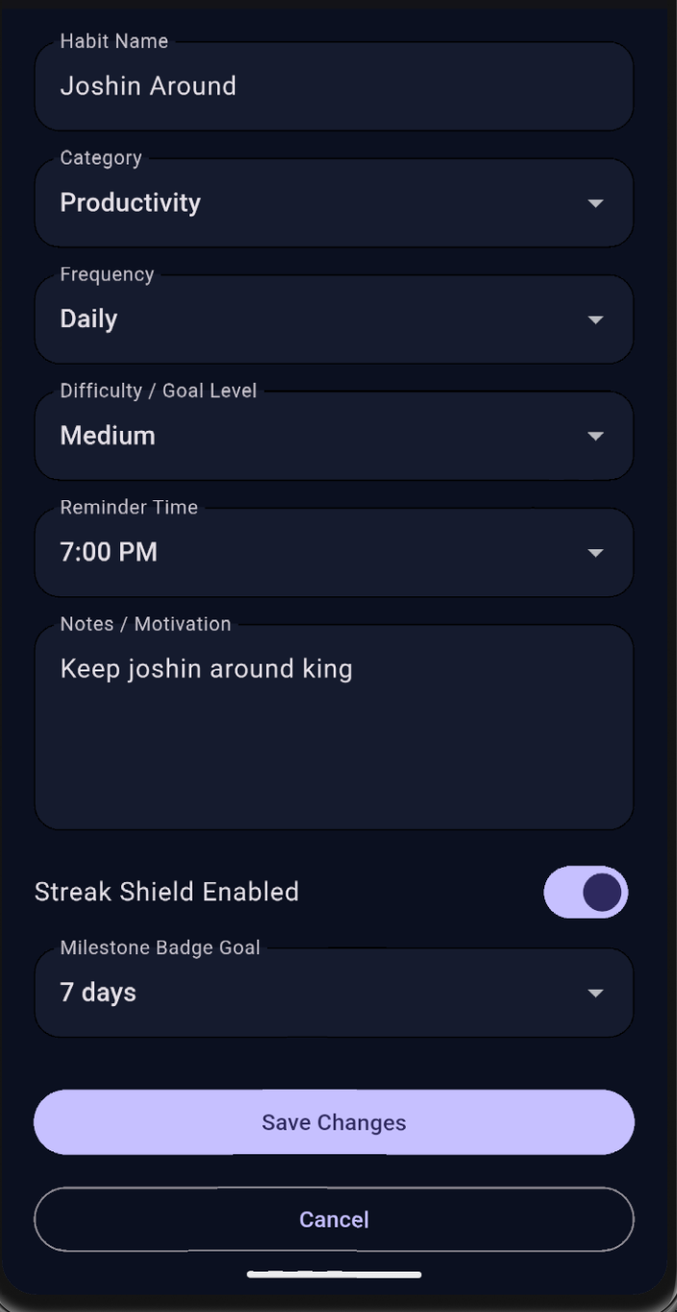
Habit Creation & Editing
Main Features
Create new habits with custom details
Edit existing habits
Set category, frequency, and difficulty
Add reminder times for notifications
Include notes or motivation for each habit
Enable streak shield and milestone goals

Slide 12
Habit Details & Progress
Main Features
Displays detailed habit information
Tracks current streak and consistency
Weekly completion heatmap visualization
Milestone progress toward goals
Insightful feedback based on performance
Turning habit data into meaningful progress insights

Slide 13
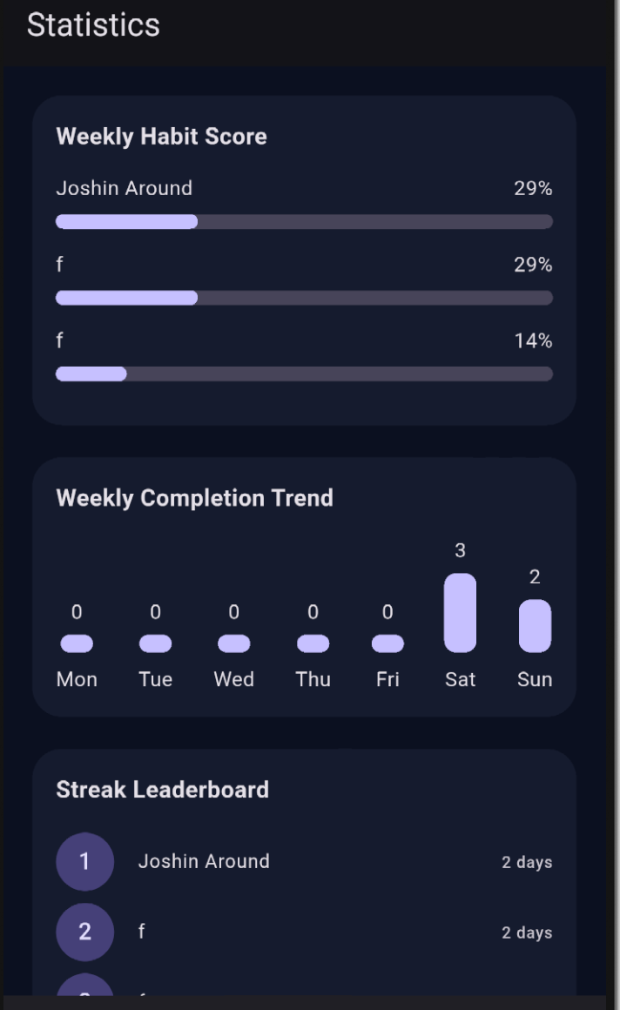
Statistics & Insights
Main Features
Weekly habit performance tracking
Completion trends visualization
Streak leaderboard across habits
Personalized habit insights
Weekly reflection and feedback
Data-driven insights to improve consistency and performance

Slide 14
UI/UX Design & Tech Stack
UI/UX Design Approach
What was our design goal?
We focused on creating a clean, intuitive, and user-friendly interface that allows users to interact with the app with minimal friction.
How did we achieve this?
Simple and consistent layout across all screens
Fast and responsive interactions (one-tap actions)
Clear visual feedback for user actions (streaks, completion states)
Dark mode design for better usability and modern aesthetics
Structured navigation with a centralized dashboard
Tech Stack Used
Framework: Flutter (cross-platform UI development)
Language: Dart
Database: SQLite (local data persistence)
State Management: (Provider / setState — use whichever you used)
Storage: Local device storage for offline access

Slide 15
State Management
Approach:
Used setState for UI updates
Why:
Simple and efficient for app scale
State is localized to screens
Behavior:
UI rebuilds after data changes
Reflects updated completion and streaks

Slide 16
Data Integrity
Data Integrity Measures:
Prevent duplicate habit completions
UNIQUE(habit_id, log_date) constraint
Input validation (e.g., empty habit name)
Boolean values stored as integers (0 or 1)

Slide 17
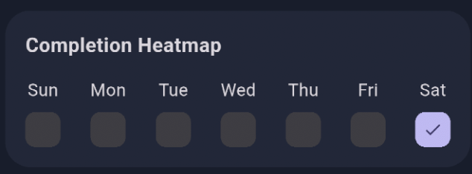
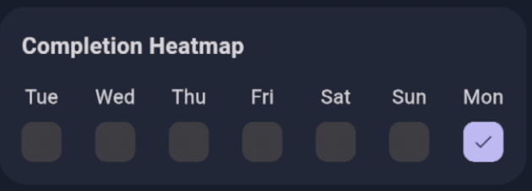
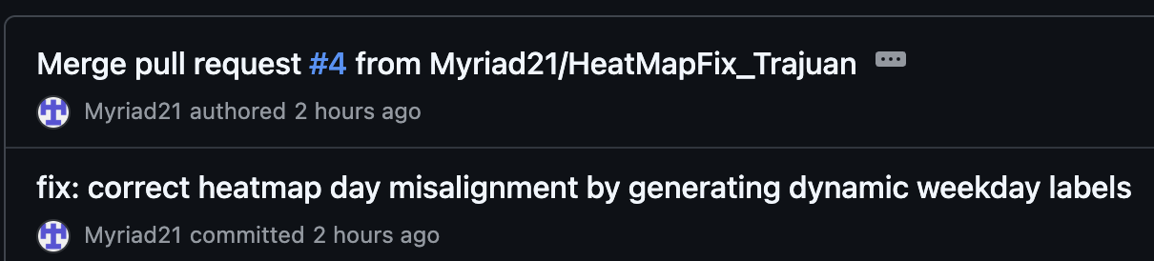
Bug & Fix
Failed Approach
Adjusting UI display without fixing date logic mismatch
Heatmap Misalignment
Fix
Bug
Generated dynamic weekday labels from same date logic
Aligned UI with repository date calculations
Habit completions appeared under incorrect weekdays
Date: Monday - 23rd
Result
Heatmap correctly reflects actual completion days
Date: Monday - 23rd
Cause
UI labels were hardcoded (Mon–Sun)
Data used rolling 7-day range from current date

Slide 18
Team Collaboration
Role Division:
Workflow:
Outcome:
Raiyan - UI & Navigation
Trajuan - Database & Application Logic
Separated responsibilities by layer
Integrated features through shared repository
Tested features after integration
Clear ownership of components
&
Efficient development process

Slide 19
Development-Cycle Improvement
Priority:
Improve testing and validation process
Why:
Catch UI–data mismatches earlier
Prevent bugs like heatmap misalignment
Approach:
Add structured testing for date-based features
Validate UI against repository data logic
Impact:
More reliable features
Faster debugging and iteration

Slide 20
Conclusion
This app demonstrates…
#1
#2
Full-stack mobile application development
Local data persistence
(SQLite & SharedPreferences)
#3
#4
Clean layered architecture
design
User-focused design

Slide 21
THANK YOU
Any questions?

